Slide 1
Rain Fall Prediction
Presented by Mohammed insaf vp
Date of presentation 5-4-2025

Slide 2
Introduction
Problem statement: Predict whether it will rain tomorrow based on weather data
Real-world importance: Agriculture, transportation, disaster prepare, and daily planning
ML Role: Learns patterns in weather to make accurate predictions.

Slide 3
Objectives
To predict whether it will rain tomorrow based on daily weather data using machine learning models.
What We Aim to Achieve
Build a predictive model that can classify whether the next day will have rain (Yes/No)
Understand how weather variables (e.g., humidity, temperature, pressure, cloud cover) impact rainfall
Improve prediction accuracy to support agriculture, travel planning, and disaster preparedness

Slide 4
Dataset Overview
Kaggle Dataset (Provided by the Australian Bureau of Meteorology)
Size & Features
Total Records (Rows): 145,460
Number of Features (Columns): 23
Time Span Covered: 10 years (2007 to 2017)
Target Variable: RainTomorrow (Yes/No)

Slide 5
Data types
Categorical Features (Object/String)
Date
Location
WindGustDir
WindDir9am
WindDir3pm
RainToday
RainTomorrow
Numerical Features (Float64)
MinTemp
MaxTemp
Rainfall
Evaporation
Sunshine
WindGustSpeed
WindSpeed9am
WindSpeed3pm
Humidity9am
Humidity3pm
Pressure9am
Pressure3pm
Cloud9am
Cloud3pm
Temp9am
Temp3pm

Slide 6
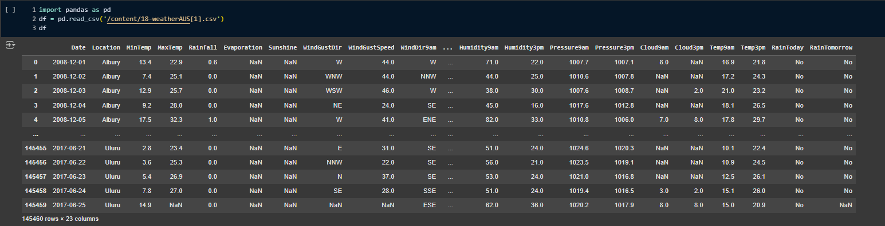
Challenges in the Dataset
Missing Values: Several features have missing data:
Evaporation: 43% missing
Sunshine: 48% missing
Cloud3pm: 41% missing
Pressure: 10% missing
Imbalanced Target:
More "No" values than "Yes" in RainTomorrow
Outliers:
Some extreme values observed in rainfall, wind speed, and temperature readings

Slide 7
Methodology
1. Data Loading and Initial Exploration
Load the weatherAUS dataset into a pandas DataFrame.
Examine the data's shape, info (data types, non-null values), and descriptive statistics.
Visualize data distributions: a. Bar plots, pie charts, and count plots for categorical features.
Histograms and box plots for numerical features.
Analyze correlations between numerical features using a heatmap and pair plots.
2. Data Cleaning
Handle missing values: a. Remove columns ('Sunshine', 'Evaporation', 'Cloud9am', 'Cloud3pm') with a high percentage of missing values.
Fill missing values in numerical features using mean imputation (normally distributed) or median imputation (skewed data).
Fill missing values in categorical columns using the mode,mean.
Remove duplicate rows.

Slide 8

3. Data Preprocessing
Convert the 'Date' column to datetime objects.
Encode categorical features ('RainToday', 'RainTomorrow', 'Location', 'WindGustDir', 'WindDir9am', 'WindDir3pm') using Label Encoding.
Handle Skewness: a. Apply log1p transformation to the 'Rainfall' column.
Apply sqrt transformation to the 'WindGustSpeed' column. c. Scale specific columns ('MinTemp', 'MaxTemp', 'Temp3pm') using StandardScaler.
4. Outlier Handling
Identify outliers in numerical features using box plots.
Remove outliers using the Interquartile Range (IQR) method.
5. Class Imbalance Handling (SMOTE)
Observe the class distribution of the 'RainTomorrow' target variable.
Apply the SMOTE algorithm to oversample the minority class (if needed) to balance the class distribution.

Slide 9
6. Dimensionality Reduction (PCA - Optional)
Apply Principal Component Analysis (PCA) to reduce the number of features while preserving essential information.
Visualize the data projected onto the principal components.
7. Model Building and Evaluation
Split data into training and testing sets.
Train multiple classification models: Logistic Regression, RandomForest, XGBoost, K-Nearest Neighbors.
Evaluate models using: accuracy, precision, recall, F1-score, ROC-AUC, confusion matrix, and classification report.
Select the best performing model.

Slide 10
Algorithms Used:
1. Logistic Regression (Baseline)
Simple and easy to interpret.
Good starting point to compare complex models.
2. Random Forest:
Great for handling large datasets with mixed data types.
Provides good accuracy and shows feature importance.
3. XGBoost:
Powerful and fast.
Handles complex patterns and often used in competitions.
Training Process:
Data split: 80% Training, 20% Testing
Used Cross-Validation to reduce overfitting.
Performed Hyperparameter Tuning (like Grid Search for best model settings).

Slide 11
Evaluation & Results
Metrics Used:
Accuracy – Measures the overall correctness of the model.
Precision – How many predicted rains were actually correct.
Recall – How many actual rainy days were predicted correctly.
F1 Score – Balance between precision and recall.
ROC-AUC Score – Measures model's classification ability.
Model | Accuracy | Precision | Recall | F1 Score | ROC-AUC
Logistic Regression | 72.51% | 73.39% | 70.65% | 71.99% | 0.8053
Random Forest | 92.13% | 92.65% | 91.52% | 92.08% | 0.9768
XGBoost | 91.75% | 94.90% | 88.24% | 91.45% | 0.9709

Slide 12
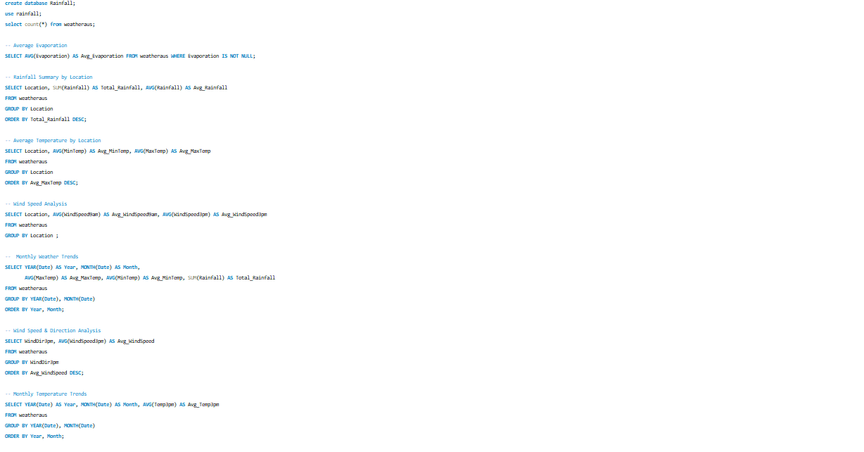

Slide 13
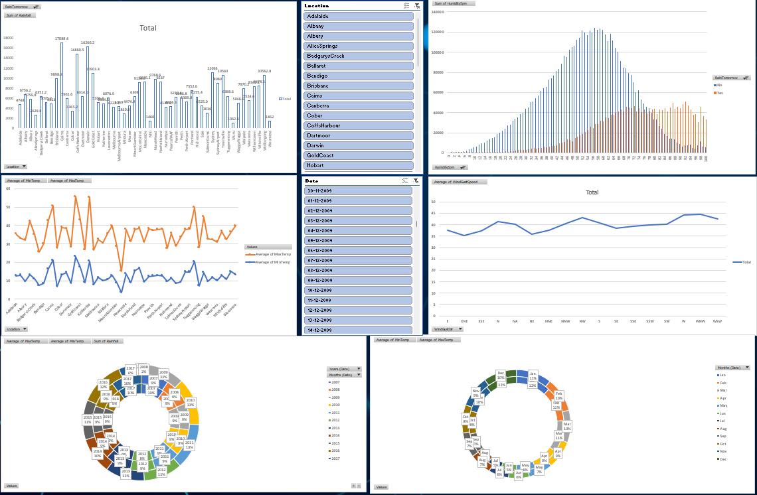

Slide 14
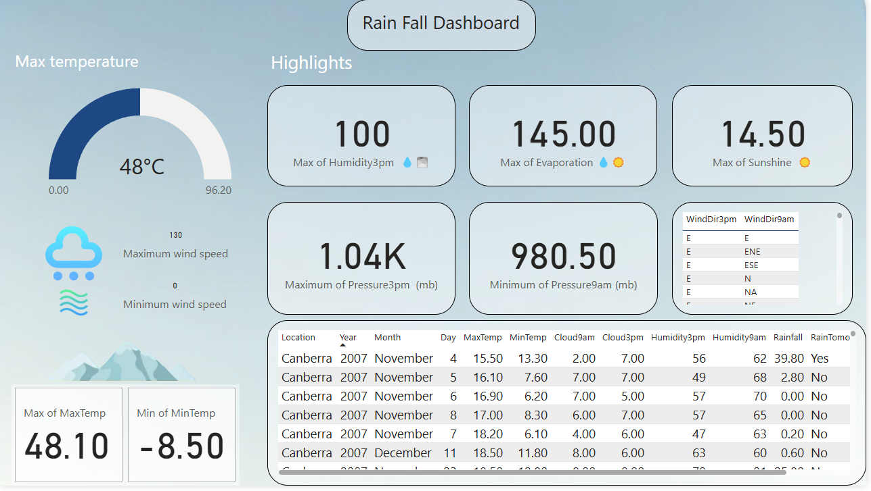
Dashboard Overview

Slide 15
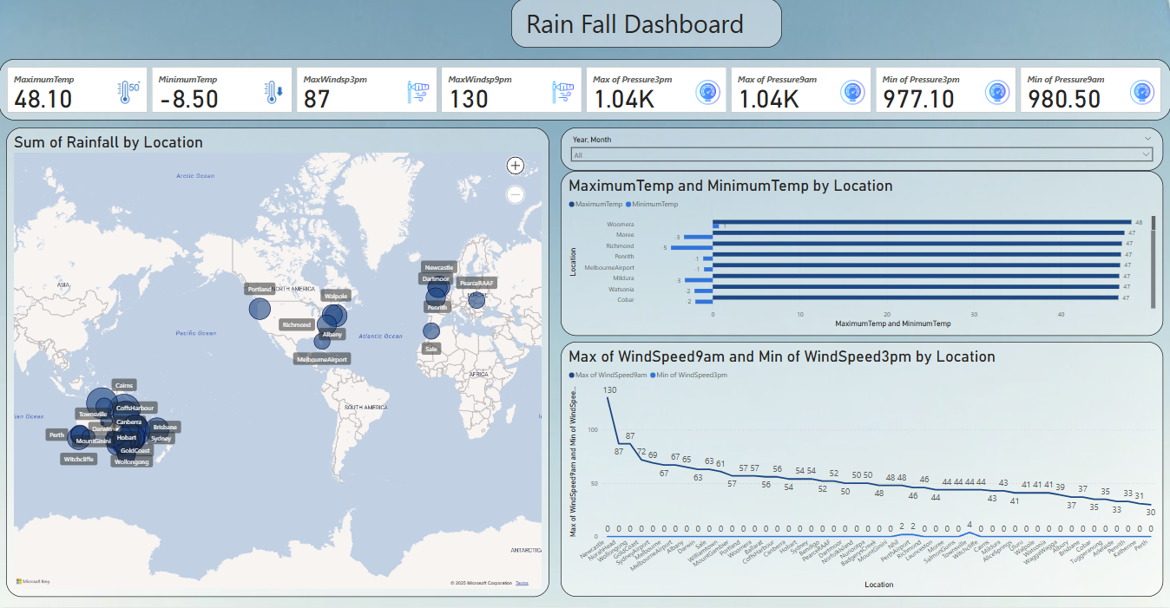

Slide 16
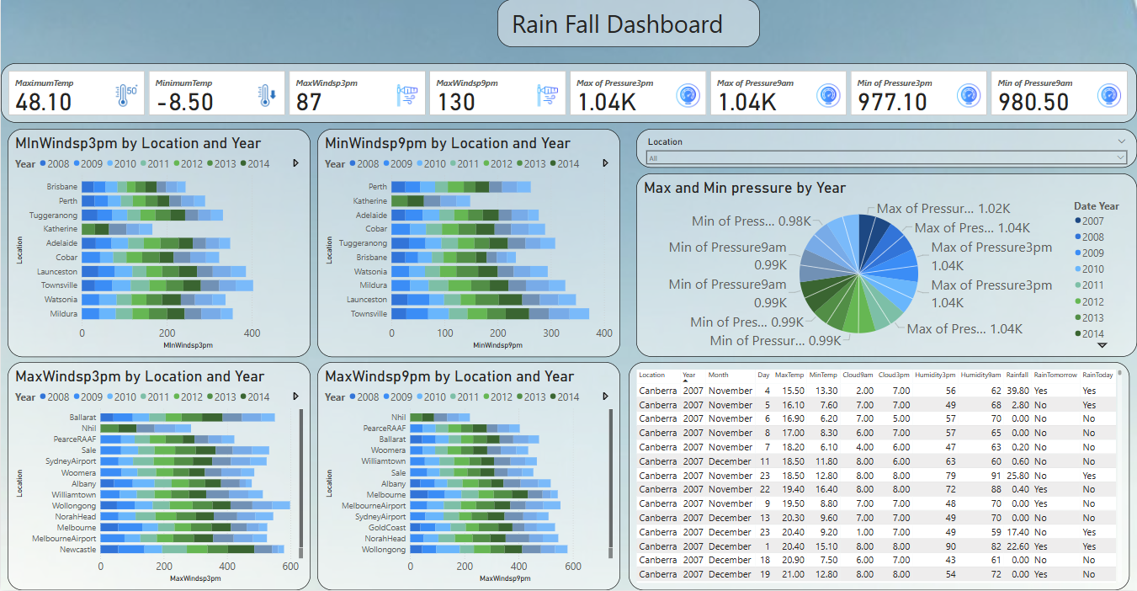

Slide 17
Difficulties Faced During the Project:
Missing Data: Many features, such as evaporation and cloud coverage, had significant missing values, requiring imputation or removal.
Imbalanced Dataset: The dataset had an imbalance in rainfall occurrences, making prediction harder for less frequent classes.
Limitations of the Approach or Model:
Bias in Data: Historical weather data may have biases that affect prediction accuracy.

Slide 18
Conclusion
Developed a predictive model to determine if it will rain tomorrow based on historical weather data.
Random Forest and XGBoost delivered the best results, achieving over 92% accuracy.
Scope for Improvement:
Data Quality: Improve performance by using more recent and high-resolution datasets.
Advanced Models: Try deep learning models (e.g., LSTM for sequential weather patterns).
Real-world Deployment: Integrate model with live weather APIs for dynamic prediction.
Future Enhancements:
Real-time data collection and analysis using IoT or weather APIs.
Build a mobile/web app for users to get live predictions.
Add visualization dashboards for real-time monitoring.

